Slide 1
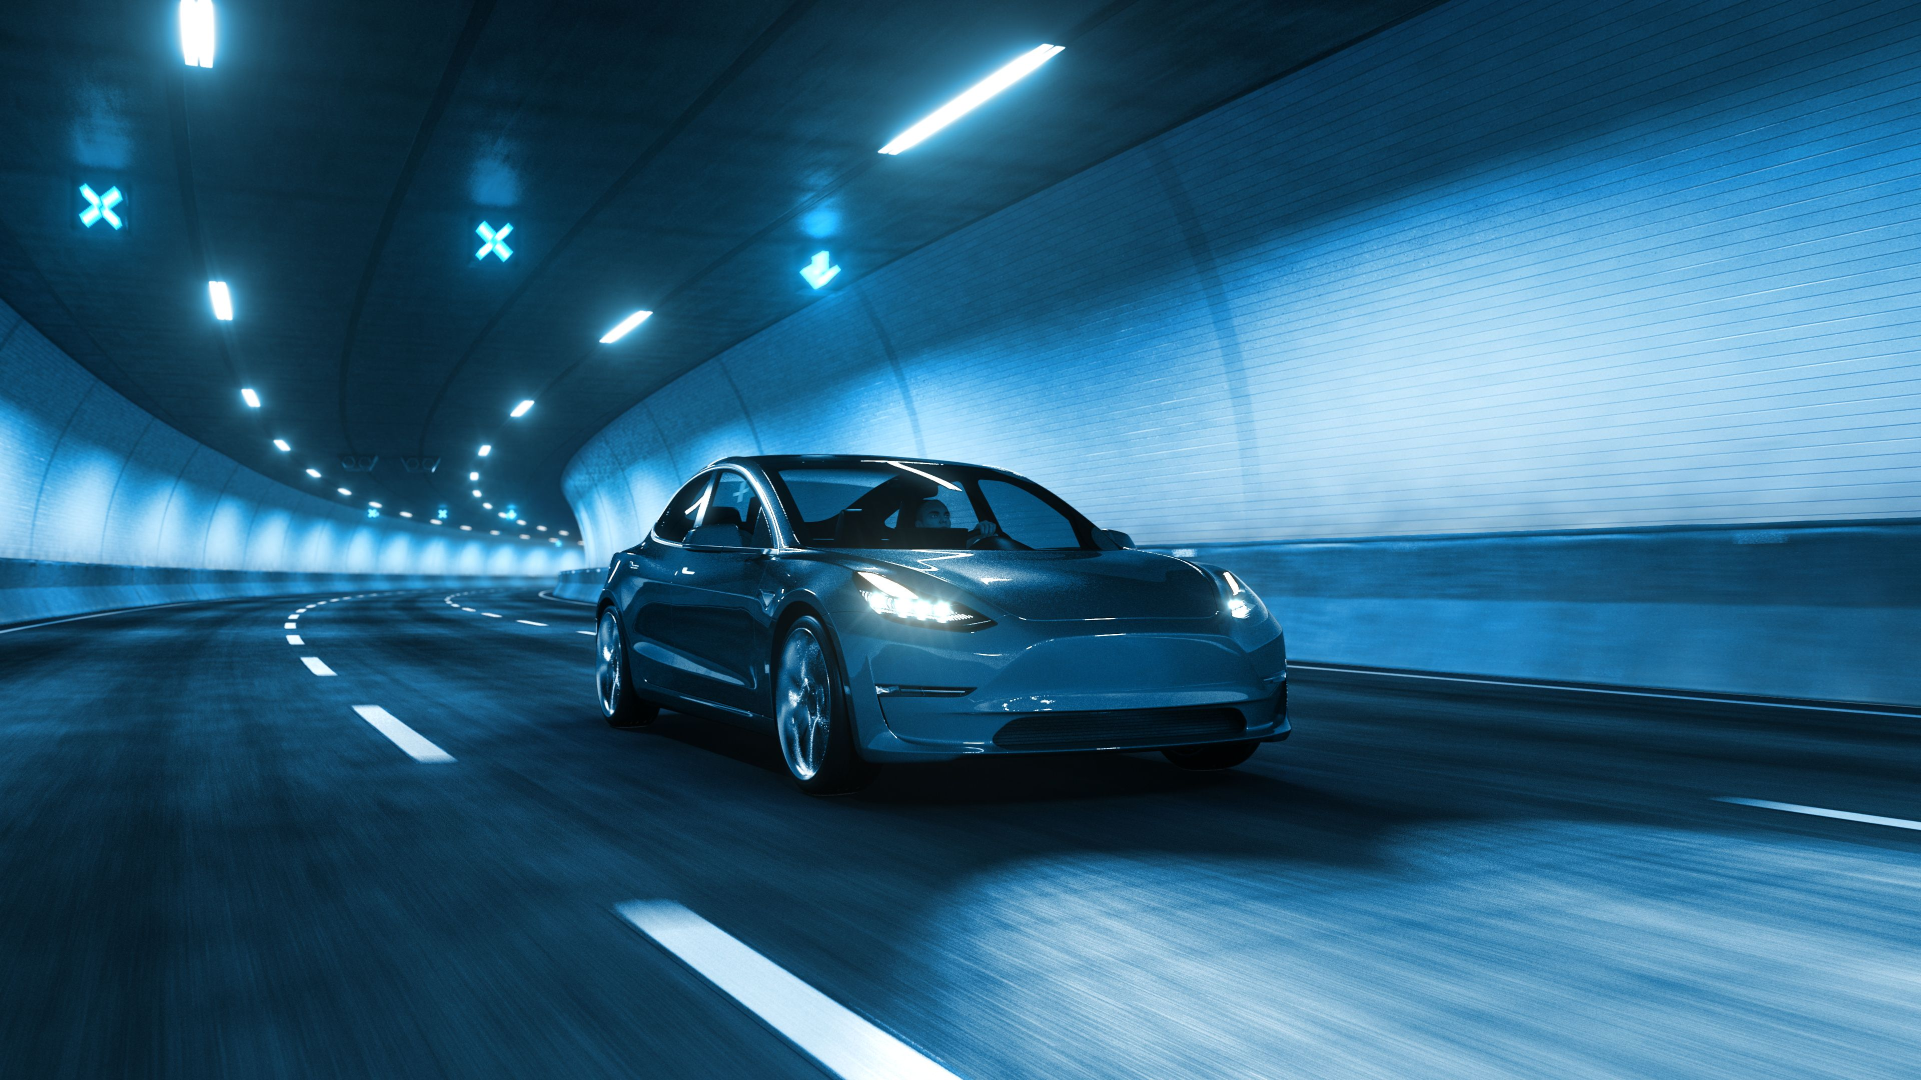
Smart Electric Vehicle With Accident
Control System
SIC IOT – 602
Team 3

Slide 2
Our Team Members
Team Leader
Eng. Youssef Abdelhakem
Team Member
Yasmeen Khaled Qotb
Shahd Mohamed Sayed
Menna Tallah Khaled Mahmoud
Abdallah Ahmed Abdallah
Mahmoud Alsonbaty
Mohamed Mamdouh

Slide 3
AGENDA
PRESENTATION
Introduction
Components
Mechanism
Challenges
Testing and Results
References

Slide 4
INTRODUCTION

Slide 5
Do you know how many people die every year due to road accidents?

Slide 6
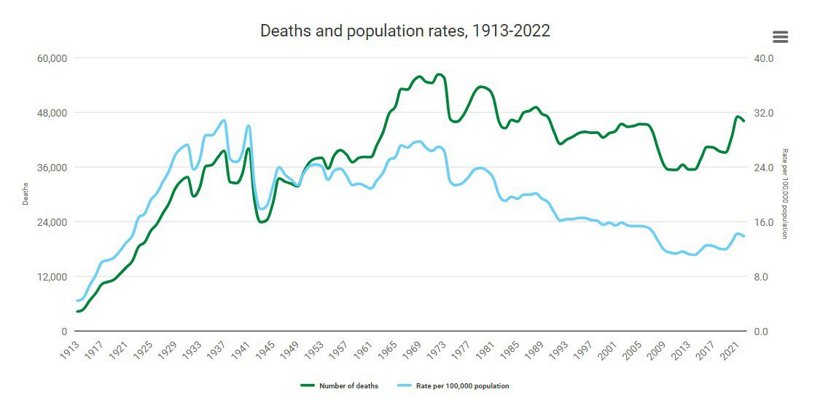
According to WHO, approximately 1.19 million people die each year due to road traffic crashes
while an estimated 20 to 50 million suffer non-fatal injuries

Slide 7
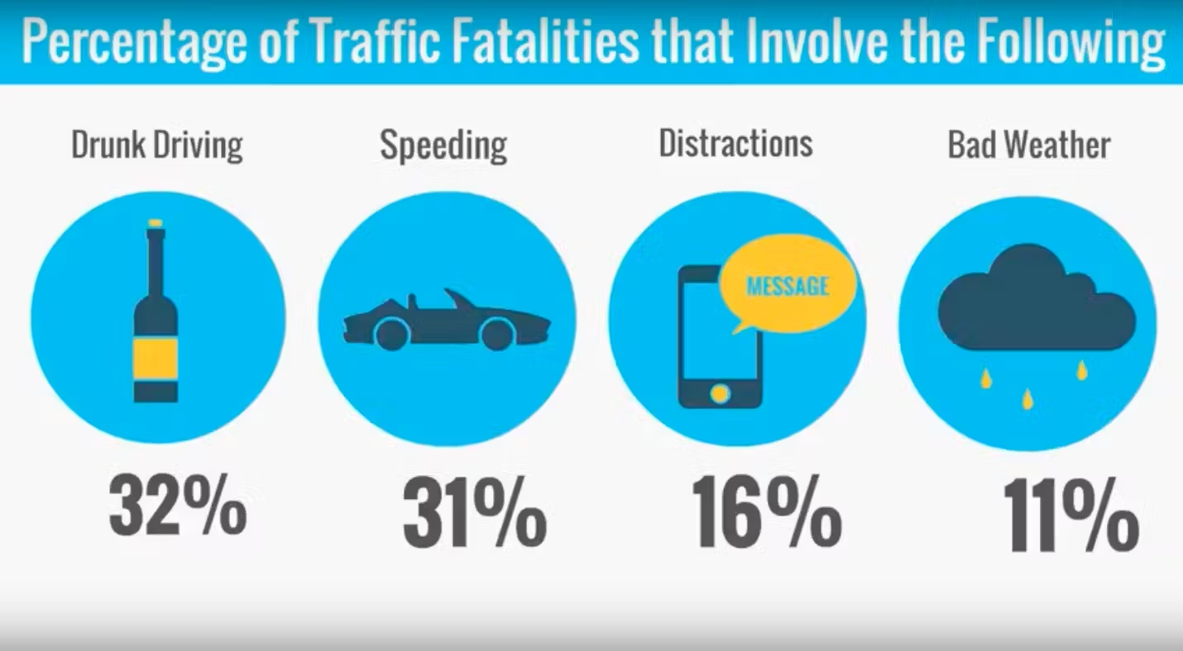
Common Causes of Car Accidents in St. Petersburg

Slide 8





Challenges:
Avoid driving when the driver is drunk
Avoid driving when the phone rings
Providing all the information about weather to avoid driving in terrible weather
Sending notification to the ambulance and the one he registered his number in the mobile app in case of an accident

Slide 9
Components

Slide 10
Raspberry pi 4 Model B
Arduino Uno
Sensors
Motors

Slide 11
Project Mechanism

Slide 12
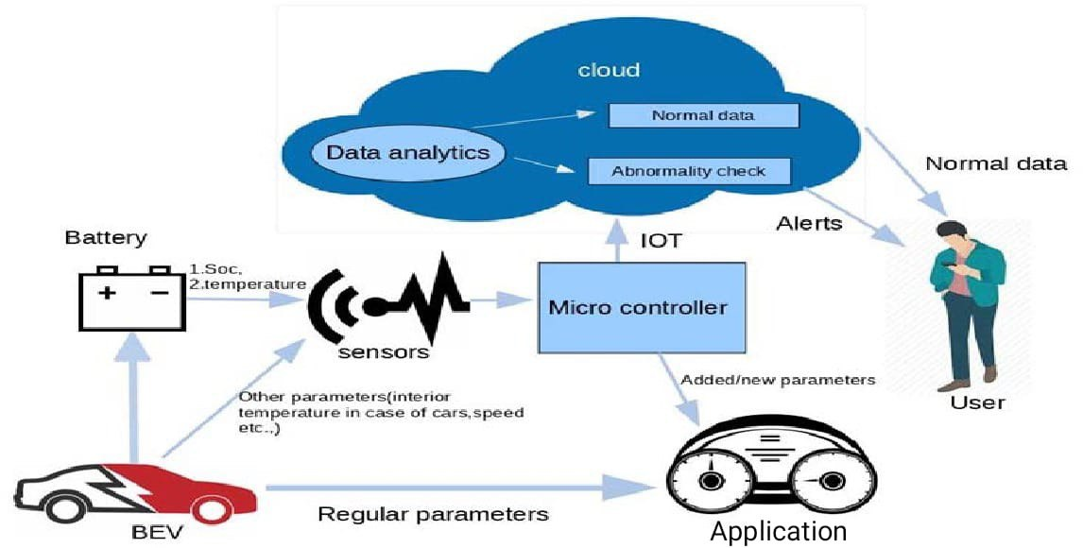
Smart EV with Accident Control System

Slide 13
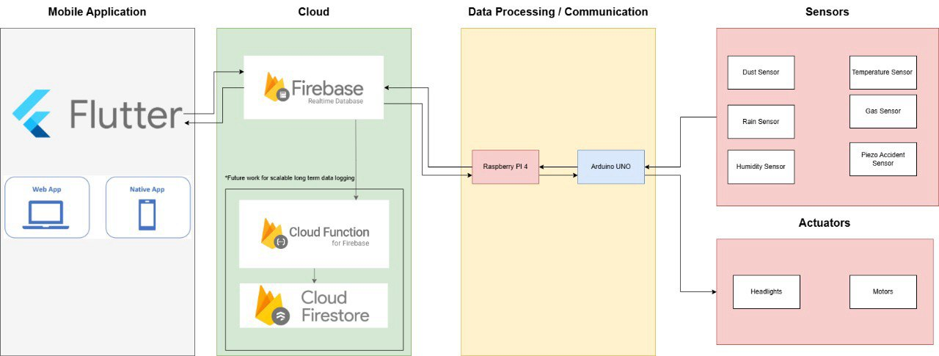

Slide 14
Mobile Detector Sensor
How the circuit works?
Antenna (Labeled "Mobile Phone D"): This is the component that detects mobile phone signals. It acts as a sensor to pick up radio frequency (RF) waves emitted by nearby mobile phones.
Operational Amplifier (LM358): The LM358 is an integrated circuit (IC) that amplifies the signal received from the antenna. It's commonly used in audio and signal processing applications.
Transistor (Q1, BC548): The transistor acts as a switch. When the amplified signal from the LM358 exceeds a certain threshold, the transistor turns on. This, in turn, activates the LED (D1).
LED (D1): The LED serves as an indicator. When the transistor turns on (due to detected mobile phone signals), the LED lights up, indicating the presence of an active mobile phone.
Variable Resistor (RV1, 2.2M2): This adjustable resistor allows you to fine-tune the sensitivity of the circuit. By adjusting RV1, you can set the threshold for LED activation.

Slide 15

Testing And Results

Slide 16
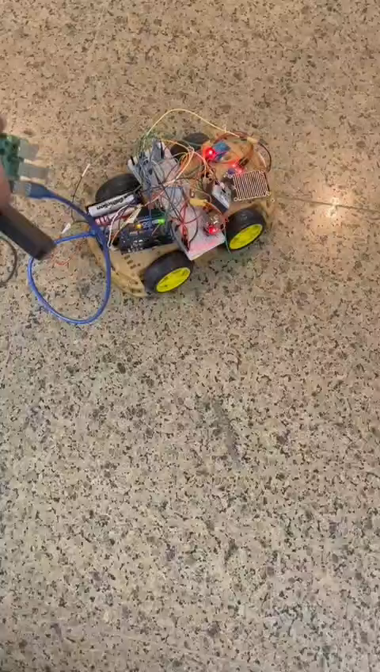
Motorts

Slide 17
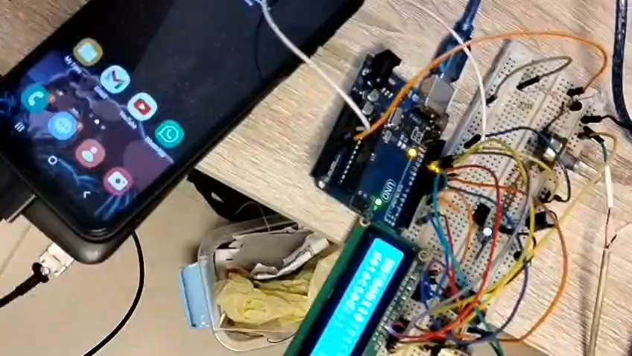
Mobile Detector Sensor

Slide 18
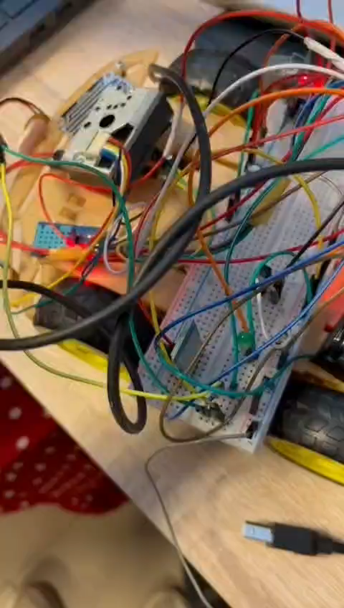
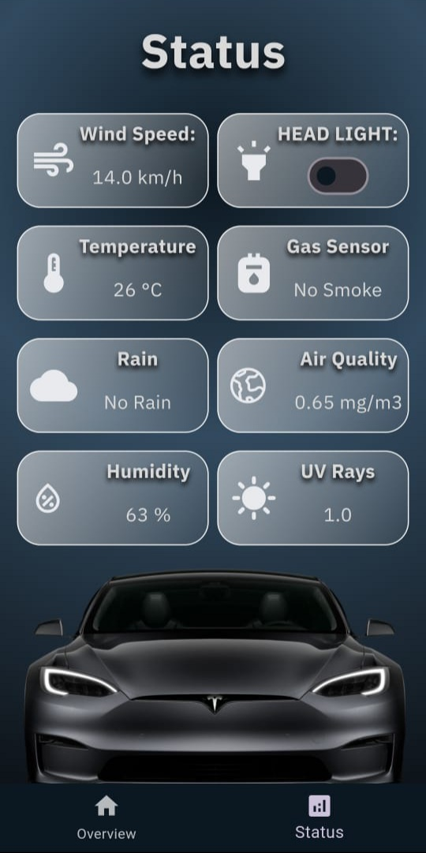
Dust Sensor

Slide 19
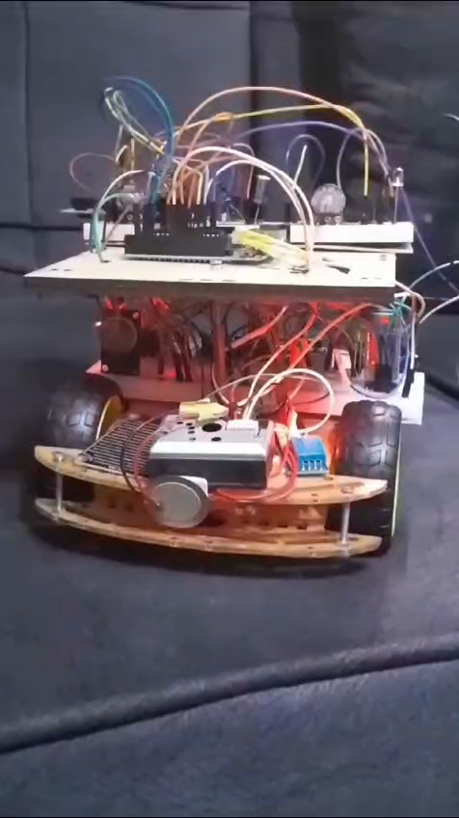

DHT 11

Slide 20
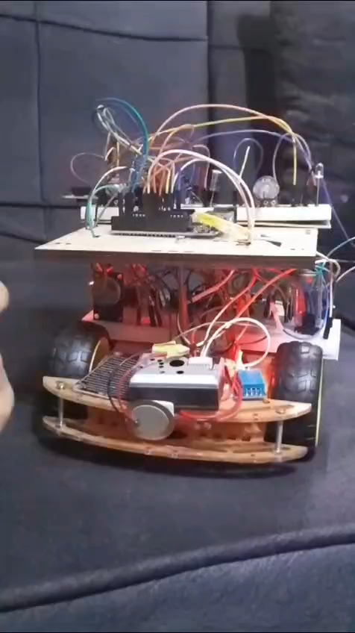

MQ -2

Slide 21
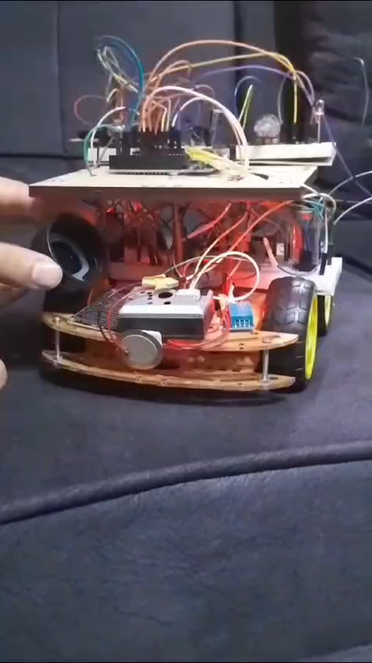

Rain Sensor

Slide 22
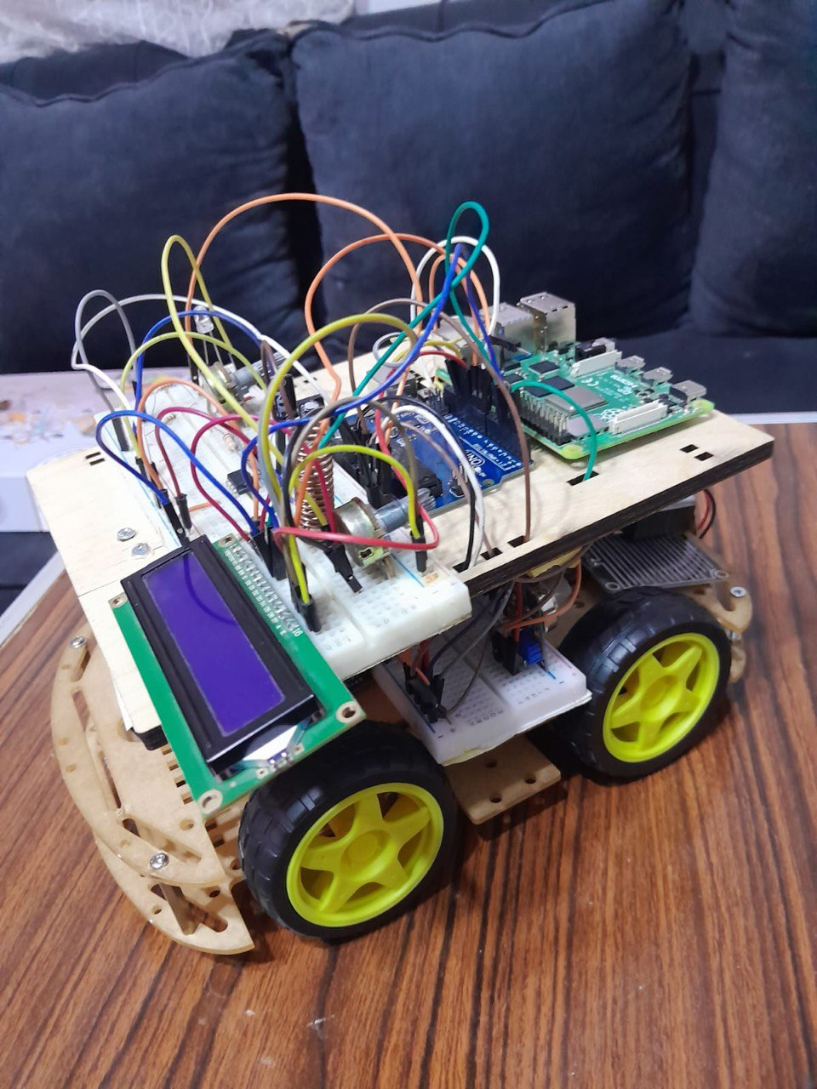
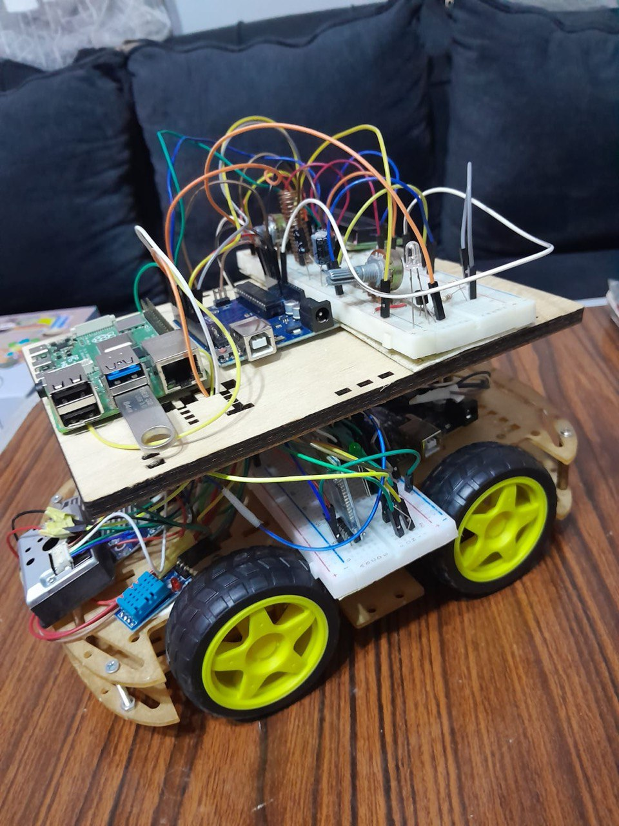
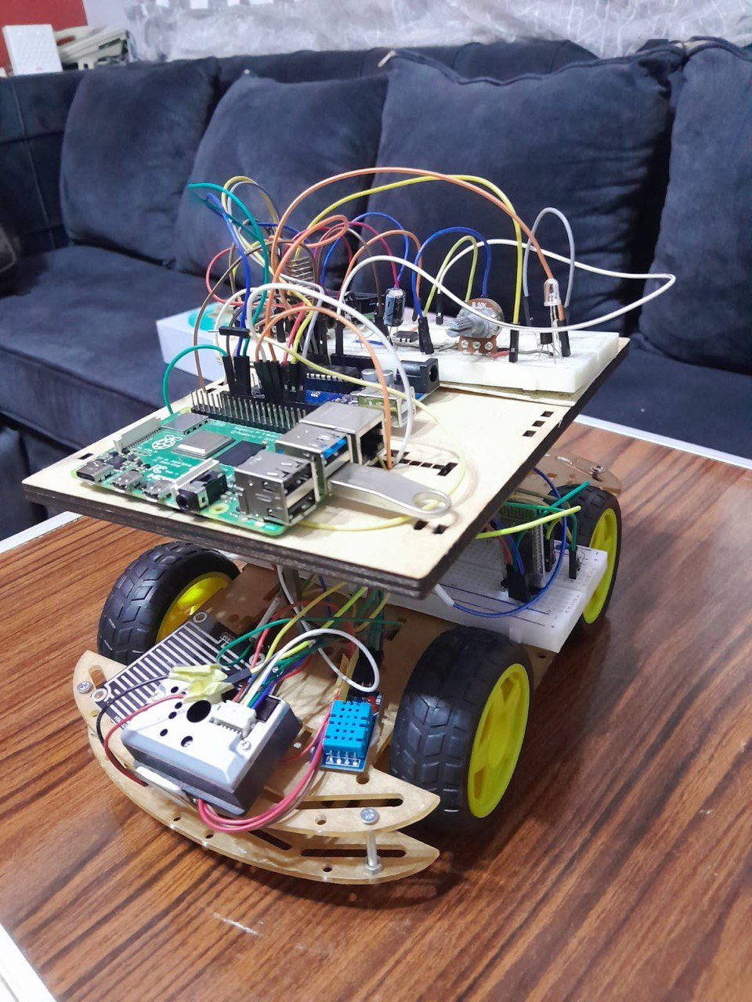
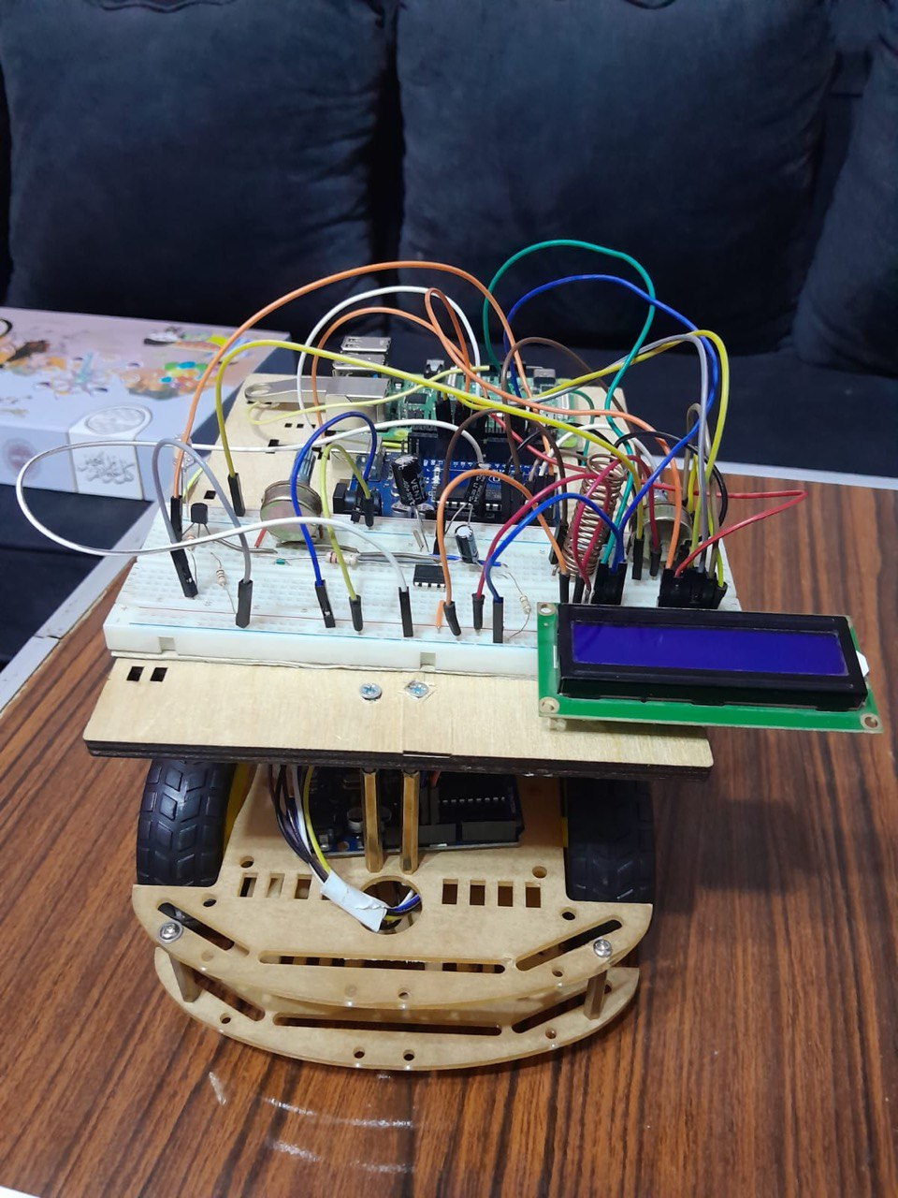

Slide 23
CONCLUSION
Accidents still occur frequently due to ineffective detection and delayed responses.
It powers off the vehicle’s motor during calls or when the driver is intoxicated.
Our project provides real-time weather updates to prevent driving in severe conditions.
The app sends accident alerts with location details to emergency services and a registered contact.

Slide 24
References
Weather influence on road accidents
https://www.sciencedirect.com/science/article/pii/S0924271622003367
Usage of sensors in making a smart EV
https://www.sciencedirect.com/science/article/abs/pii/S221478532100729X
Alert system
https://www.mdpi.com/2071-1050/14/13/7701
Statistical of no. of death from road accidents
https://www.who.int/news-room/fact-sheets/detail/road-traffic-injuries#:~:text=Between%2020%20and%2050%20million,with%20many%20incurring%20a%20disability.

Slide 25

Do you have any questions?

Slide 26

Thank You

